Slide 1
CONTENT 1. Manufacturing process 2.Additive manufacturing process 3.Types of 3D printing technology 4.Thermoplastic materials, properties and types. 5. Process of 3D printing. 6.Block diagram of 3D printing.

Slide 2
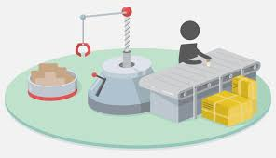
MANUFACTURING PROCESS - Manufacturing is the application of physical and chemical processes to alter the geometry, properties and or appearance of a given starting material to make parts or product.

Slide 3
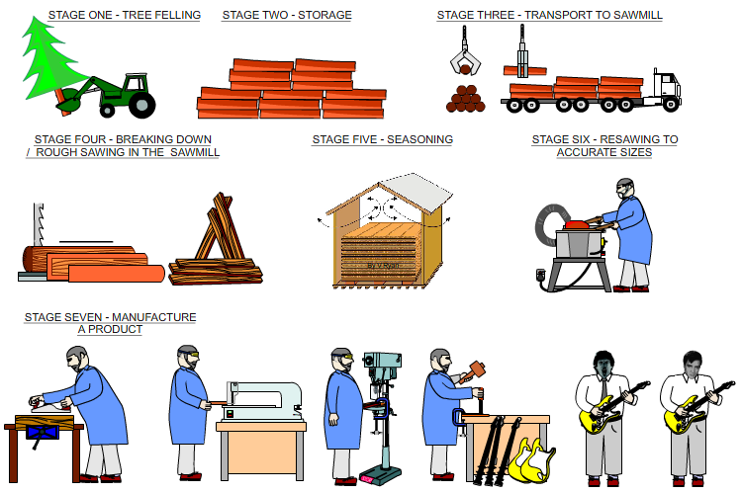
Manufacturing is the transformation of materials into items of greater value by means of one or more process and or assembly operation.

Slide 4
Manufacturing processes can be classified as processing operation and assembly operation.
In processing operation the work material is transformed from one state to other advanced state. Through this operation value is added to the work material by changing the geometry; shape properties, appearance etc. of the starting work material. Usually processing operations are performed on individual component.
In assembly operation two or more components are joined to create a new entity. The new entity is called assembly.

Slide 5
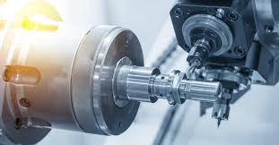
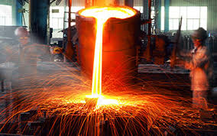
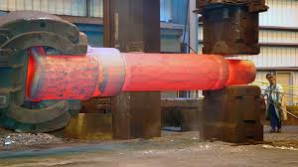
Processing operations
Machining
Casting
Forging etc….

Slide 6
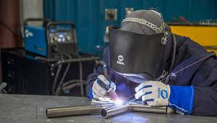
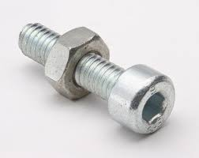
Assembly Operations
Welding
Brazing, soldering
fastener

Slide 7
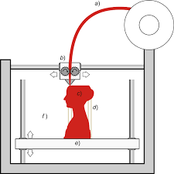
Additive Manufacturing
Additive Manufacturing (AM) refers to a process by which digital 3D design data is used to build up a component in layers by depositing material.

Slide 8
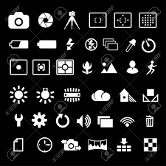
Parameters to choose AM technique
Techniques used for creating layers
Techniques of bonding the layers together
Speed
Layer thickness
Range of materials
Accuracy
Cost

Slide 9

Why AM ?
Freedom to design innovative ideas.
Encourages rapid iteration
Elimination of tooling
Green manufacturing
Minimal material wastage
Enables personalized manufacturing

Slide 10

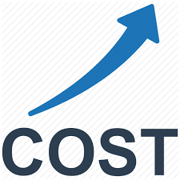
And Why not?
X - Unexpected Pre and post
processing requirements
X- High process cost
X - lack of industry standard
X- Low speed
X- Inconsistent and limited materials
X - High equipment cost.

Slide 11
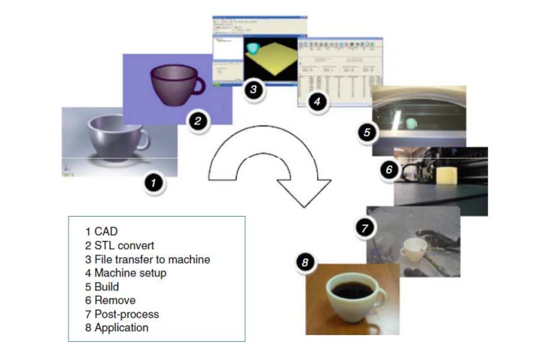
ADDITIVE MANUFACTURING PROCESS

Slide 12
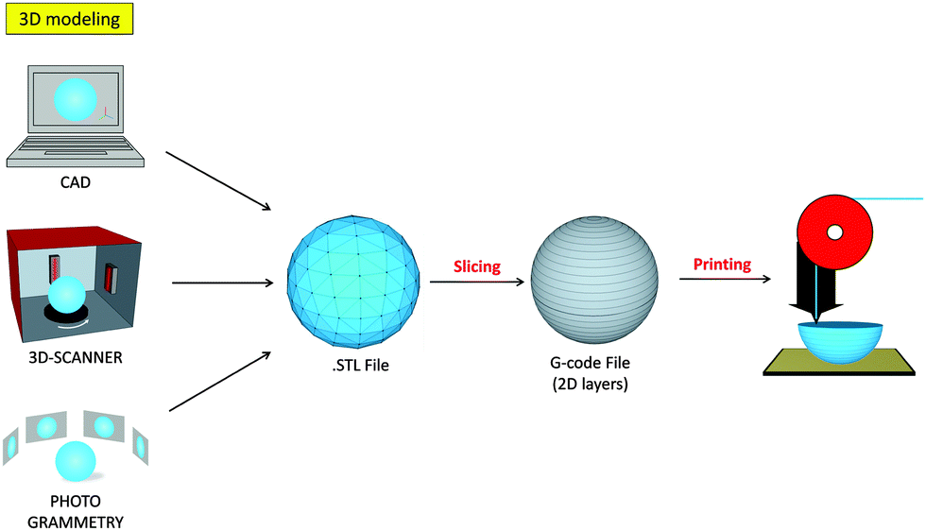
WORKING OF 3D PRINTING-BLOCK DIAGRAM

Slide 13
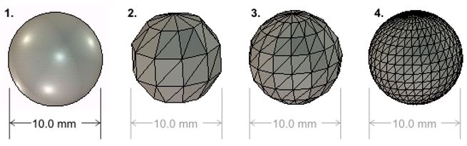
"Standard Triangle Language“-This file format is supported by many other software packages; it is widely used for rapid prototyping, 3D PRINTING and COMPUTER AIDED MANUFACTURING. STL files describe only the surface geometry of a three-dimensional object without any representation of color, texture or other common CAD model attributes.
The STL format specifies both ASCII and binary representation.

Slide 14
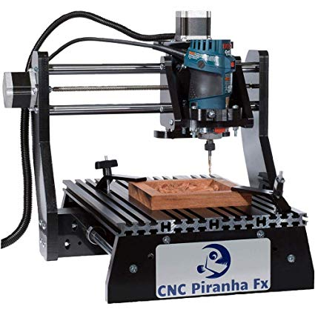
G code- Language used to control machine movement in 3 dimensions.
(G and M codes are generally used to run CNC machines.)

Slide 15
TYPES OF 3D PRINTING TECHNOLOGY
There are various 3D printing methods which were developed to build 3D structures and objects.
Selective Laser Sintering (SLS)
Fused deposition modeling (FDM)
Stereo lithography(SLA)
Digital Light Processing(DLP)
Selective laser melting (SLM)
Laminated object manufacturing (LOM)
Digital Beam Melting (EBM)

Slide 16
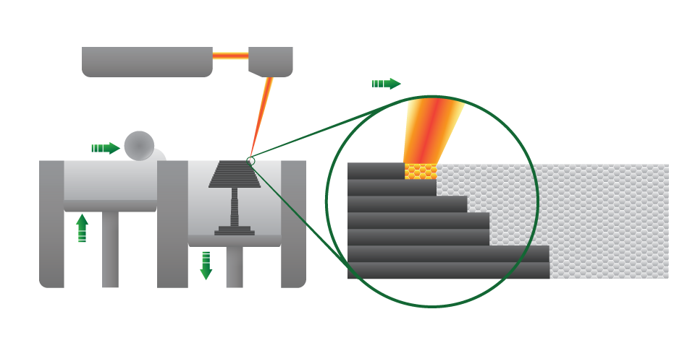
Selective Laser Sintering (SLS)

Slide 17
This builds objects by using a laser to selectively fuse together successive layers of a cocktail of powdered wax, ceramic, metal, nylon or one of a range of other materials.
The laser fuses small particles of plastic, metal, ceramic or glass powders into a 3-dimensional mass.
Using SLS, parts with complex interior components can also be printed and there is no problem of removing supports and damaging the part. As a result, time is saved on assembly.

Slide 18
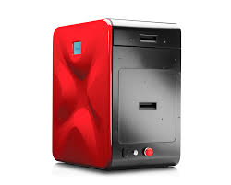
Parts printed by SLS are usually very durable and robust. This technology now rivals those produced in traditional methods like injection moulding and are already used in many end-use application like automotive and aerospace.
Starting price -5500$

Slide 19
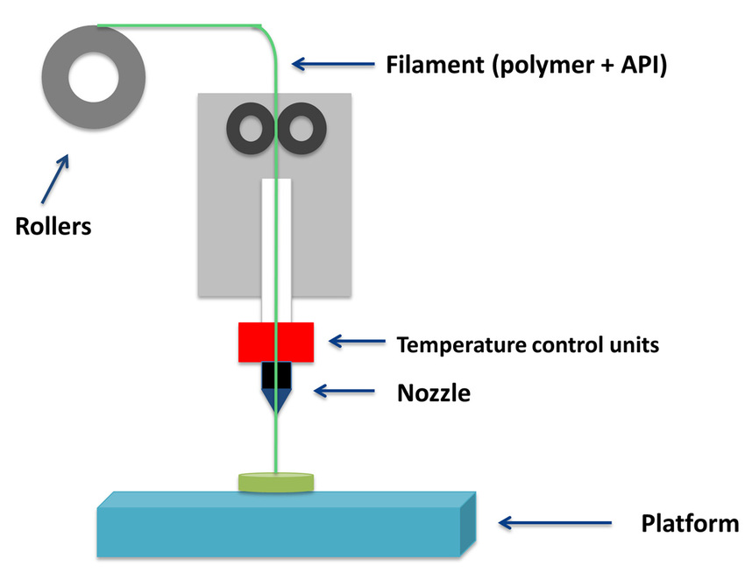
Fused deposition modeling (FDM)

Slide 20
This method uses a plastic filament or metal wire as input material to an extrusion nozzle. The nozzle is heated to melt the material and can be moved in both horizontal and vertical directions by CAM.
The material hardens immediately after extrusion from the nozzle. FDM process is less accurate. The process can also be time consuming for some particular geometry. Moreover the material used in FDM is limited to thermos plastic.

Slide 21
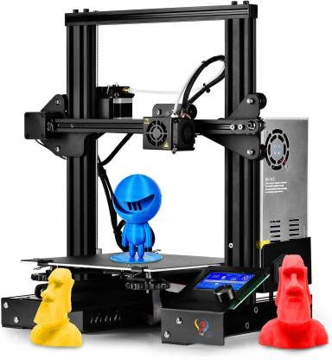
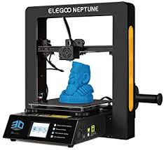
INITIAL COST( BASIC MODEL-LIMITED CAM)- 20000 INDIAN RUPEES

Slide 22
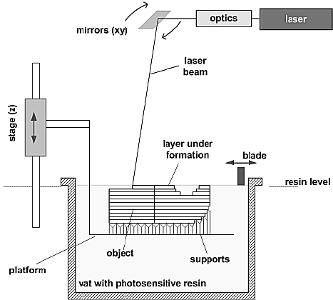
Stereo lithography(SLA)

Slide 23
SLA is used mostly to create models, prototypes and patterns. Being a laser based process; it uses ultraviolet laser and a vat of resin to build parts.
The laser beam marks the design onto the surface of the liquid polymer. Exposure to the ultraviolet laser causes the chains of atoms in the polymer gum to connect together.

Slide 24
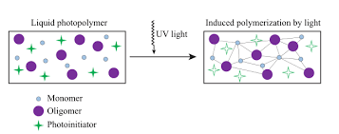
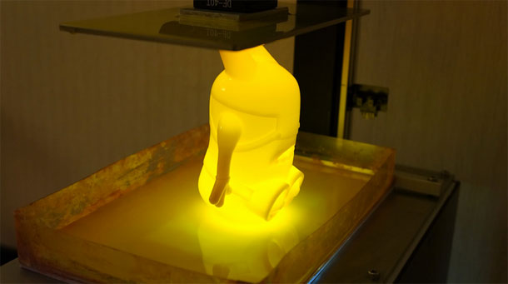

Slide 25

APPLICATIONS OF 3D PRINTING TECHNOLOGY

Slide 26
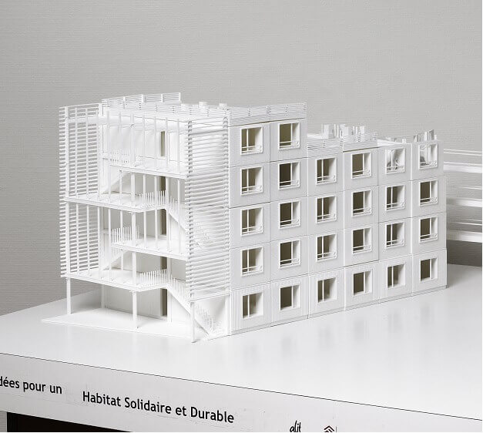
3D printing applications in Architecture and Construction
quickly materialize your ideas
give your project the best chance of success
Make your clients visualize your imagination.

Slide 27
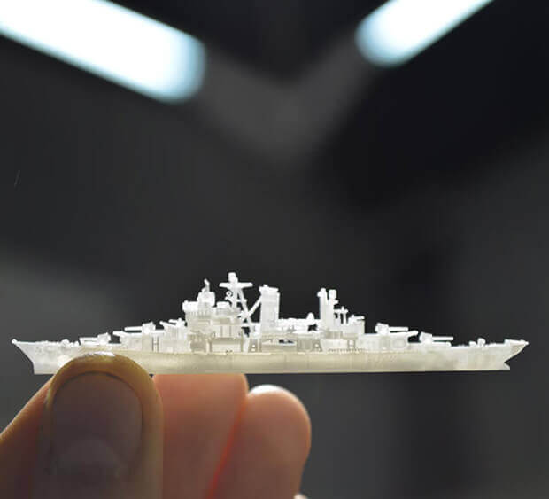
3D printing applications in Maritime Industry
Innovate faster and cheaper
Create spare parts on demand, without any stock

Slide 28
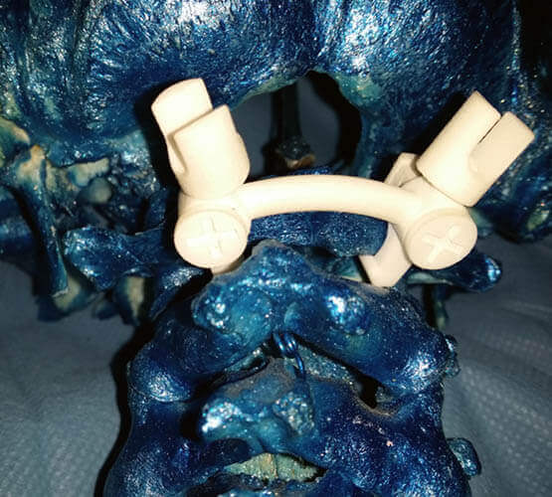
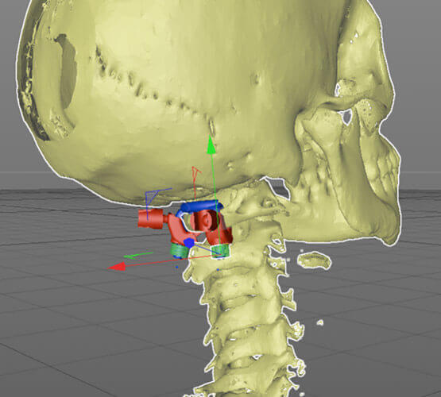
3D printing applications in Healthcare and Medical
create custom-made products for your patients
Prosthesis, orthosis and medical tools: a revolutionary offer for the medical market.

Slide 29
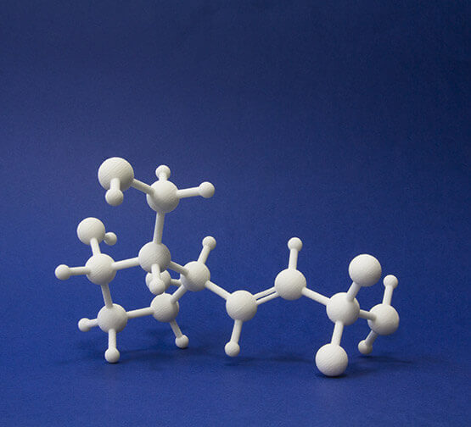
3D printing applications in Chemical Industry
3D printing molecular structures
3D print parts of your machine

Slide 30
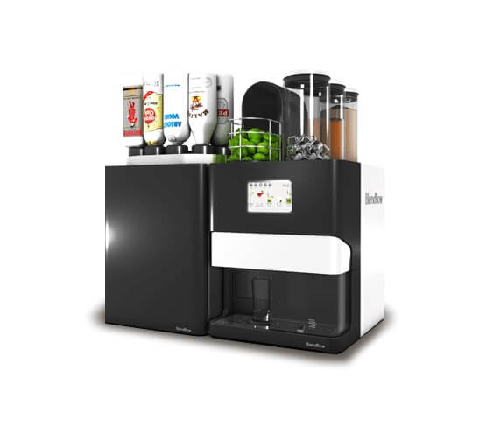
3D printing applications for Food Industry
Prototyping for tooling in the food industry

Slide 31
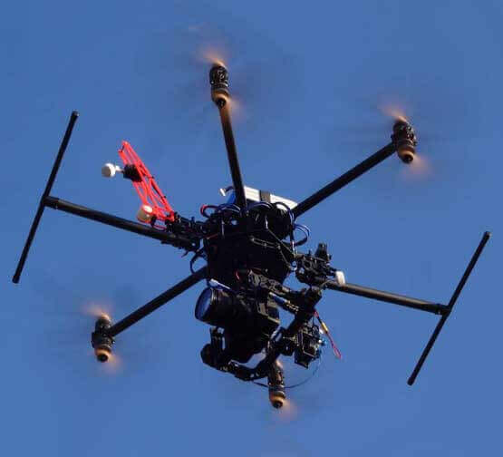
3D printing applications for Drones
Design, size and cost optimization

Slide 32
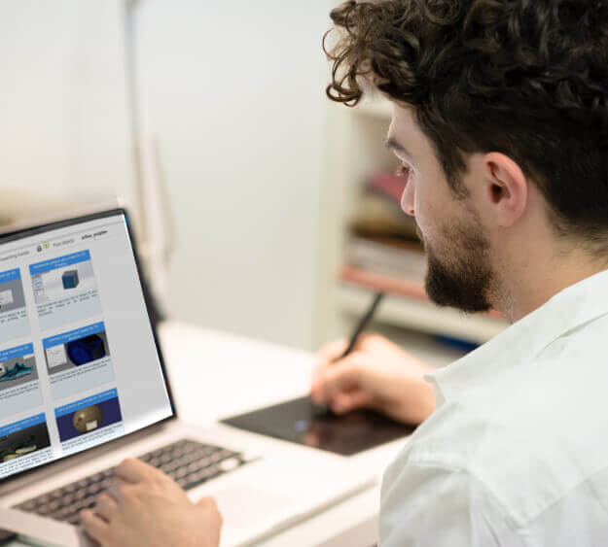
3D printing applications in Education
Technical, design or engineering curriculum: bring the professional world to your students

Slide 33
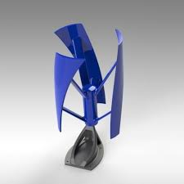
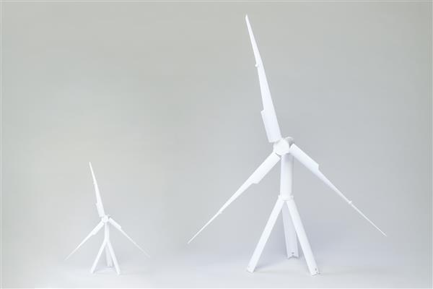
3D printing application in Energy
Fast and easy prototyping and testing

Slide 34
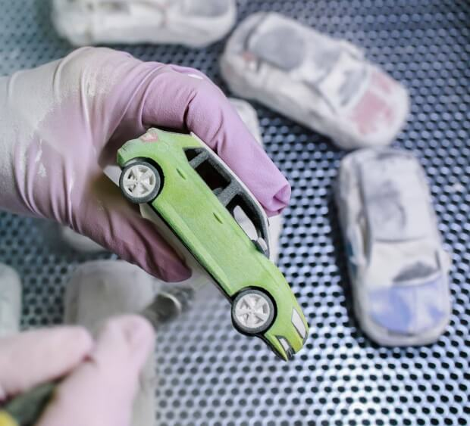
3D printing applications in Automotive
Demonstration models to sell your products

Slide 35
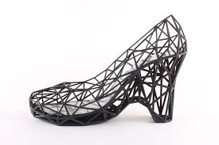
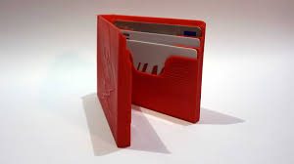
3D printing applications in Textile and Fashion
New structures within the textile industry
New material to the textile industry

Slide 36
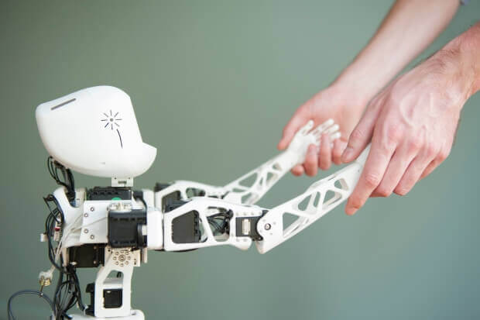
3D printing applications in Robotics
Rapid prototype parts that fit your robot
Work without constraints to achieve the perfect design

Slide 37
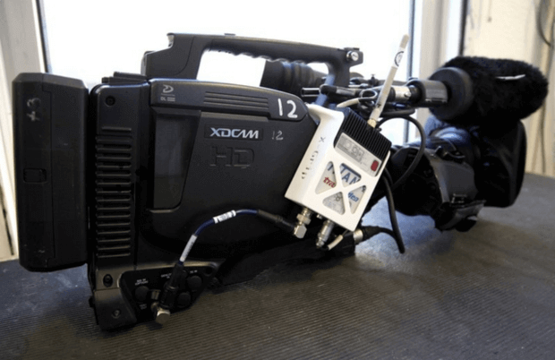

3D printing applications in Entertainment & Broadcasting
Create perfect objects for using in a TV show
Create sculptures, buildings, beasts etc..
Invent accessories to make your shooting easier

Slide 38
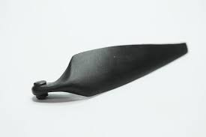
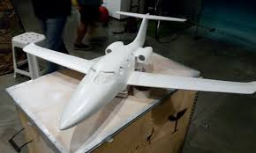
3D printing applications in Aeronautics and Space
Quick models to perform analysis.
Innovative designs.

Slide 39
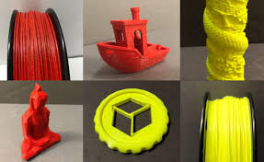
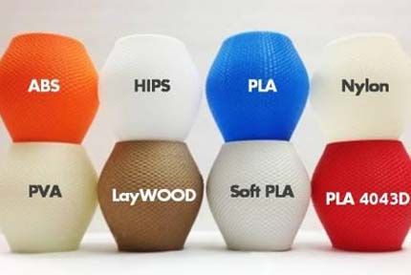
3D PRINTING MATERIAL

Slide 40
THERMOPLASTICS
The material that softens when heated above the glass transition temperature or melting temperature and becomes hard after cooling is called thermoplastics.
Thermoplastics can be reversibly melted by heating and solidified by cooling in limited number of cycles without affecting the mechanical properties.

Slide 41
PROPERTIES OF THERMOPLASTICS
High Strength And Toughness
Better Hardness
Chemical Resistance
Durability
Self-lubrication
Transparency and Water Proofing
(**List out advantages and disadvantages of thermoplastics)

Slide 42
MATERIAL | MELTING TEMPERATURE (IN ^{O}C)
Acrylonitrile Butadiene Styrene (ABS) | Its glass transition temperature is ~105 °C. ABS is amorphous and therefore has no true melting point; however 230°C is the standard for printing.
Acetals | 175
Acrylics | 160
Cellulosics | 260-270
Polyamides | 250-260
Polycarbonates | 155
Polyethylene | 240
Polystyrenes | 240
Polyvinyl Chloride (PVC) | 110-260
Liquid Crystal Polymers (LCP) | 280-300

